Slide 1
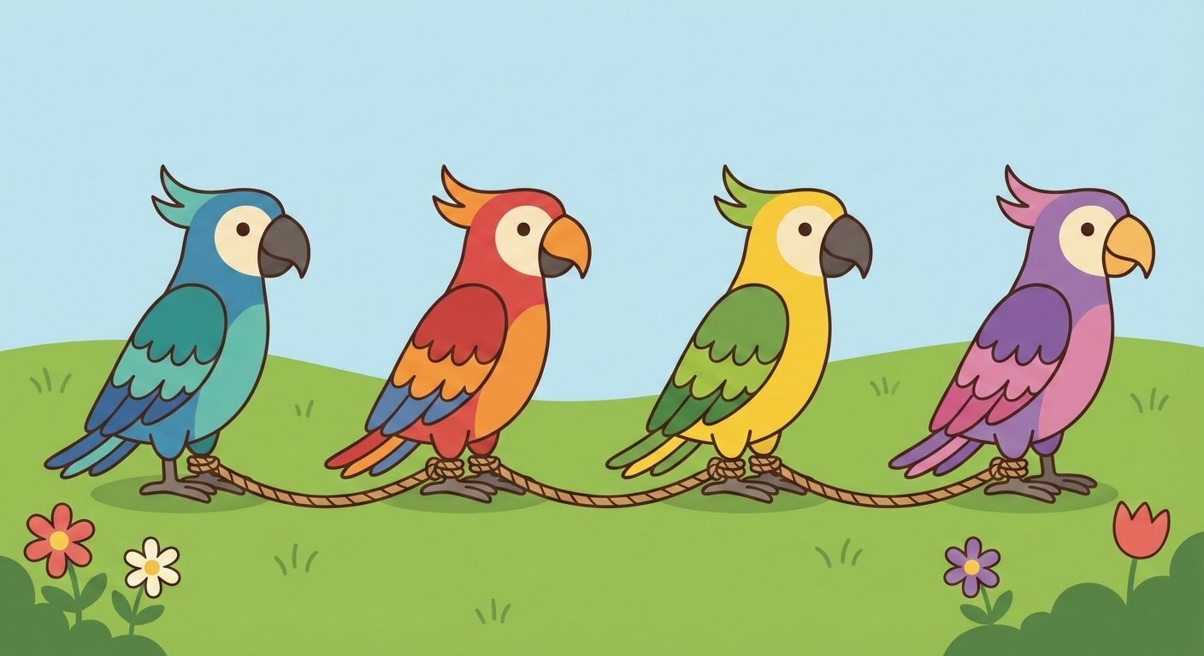

Agentic AI with LangChain and LangGraph
Presentation 6: Intro to LangGraph
Primary Instructor: Michael Z
RA: YH
Date: 2026.Jan-Feb

Slide 2
0. I wish you did the QuickStart of LangGraph (Graph API only). You can do it now if you didn’t

Slide 3
1. Think in Graph

Slide 4
1. Think in Graph: Let’s chain these parrots together
Still remember the interesting explanation of LangChain logo? Unfortunately, LangChain, the Python package, alone, can’t achieve what LangChain logo means to do. LangGraph is the one you would use to chain these parrots (LLMs) together.
What are the differences between LangChain and LangGraph? Why LangGraph is a separate package, rather than a part of LangChain?

Slide 5
1. Think in Graph: Let’s think of problem step by step
When we face a problem, what’s the commonly-used pattern of thinking of solution?
For example, how to make a bowl of salad?
First, you might buy the vegetables and eggs and sauces. Second, you boil the eggs. Third, you would cut the vegetables…
You solve the problem STEP BY STEP.
In LangGraph, the step we talked about here is a node. An edge would decide what’s the next node to call.
The state = data structure (schema) + reducer (might not talk about it in this lecture), simply.
Designing multi-agent is nothing but designing a Python script to solve a problem step by step, with some logics and engineering details added, using LangGraph.
A node is basically a function and an edge is a bunch of if else bundled to decide what’s next.
If something could be done by plain LLM or agent in this node, you can simply call it multi-agent.
Actually, you could put whatever you like in a node.

Slide 6
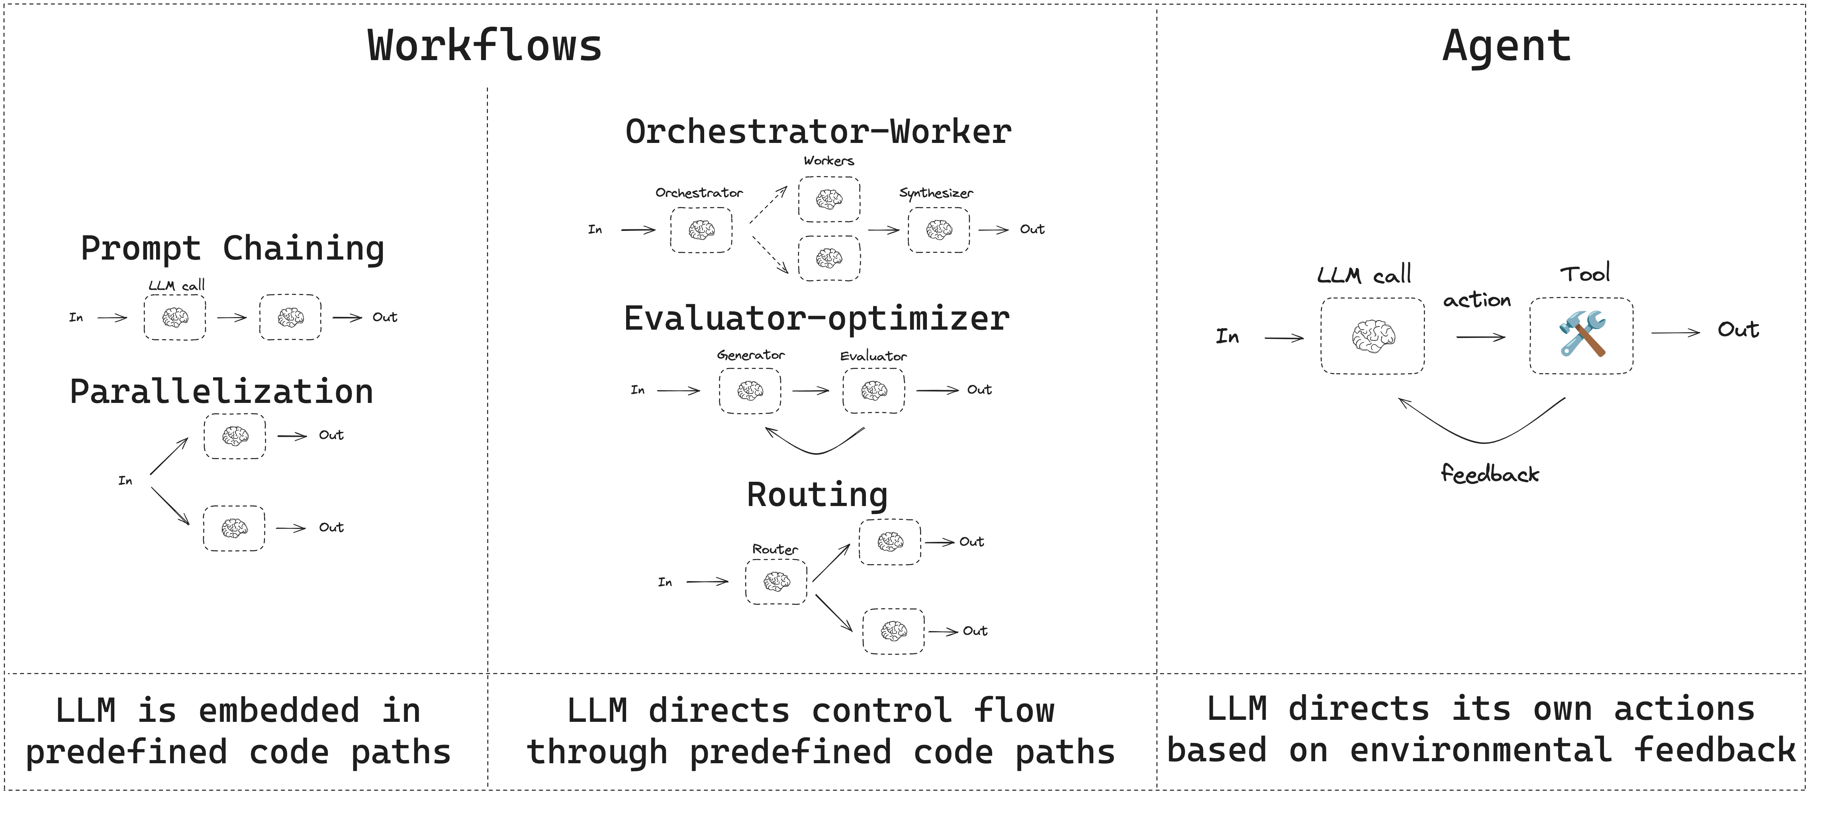
1. Think in Graph: Workflow, Agentic Workflow, Agent
I love this image cause it basically tells everything we need to know.
Source: https://docs.langchain.com/oss/python/langgraph/workflows-agents

Slide 7
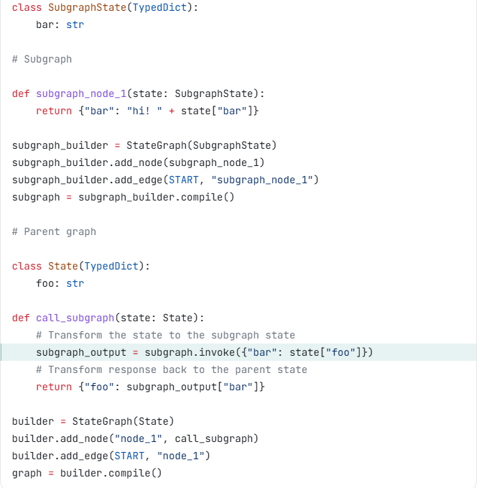
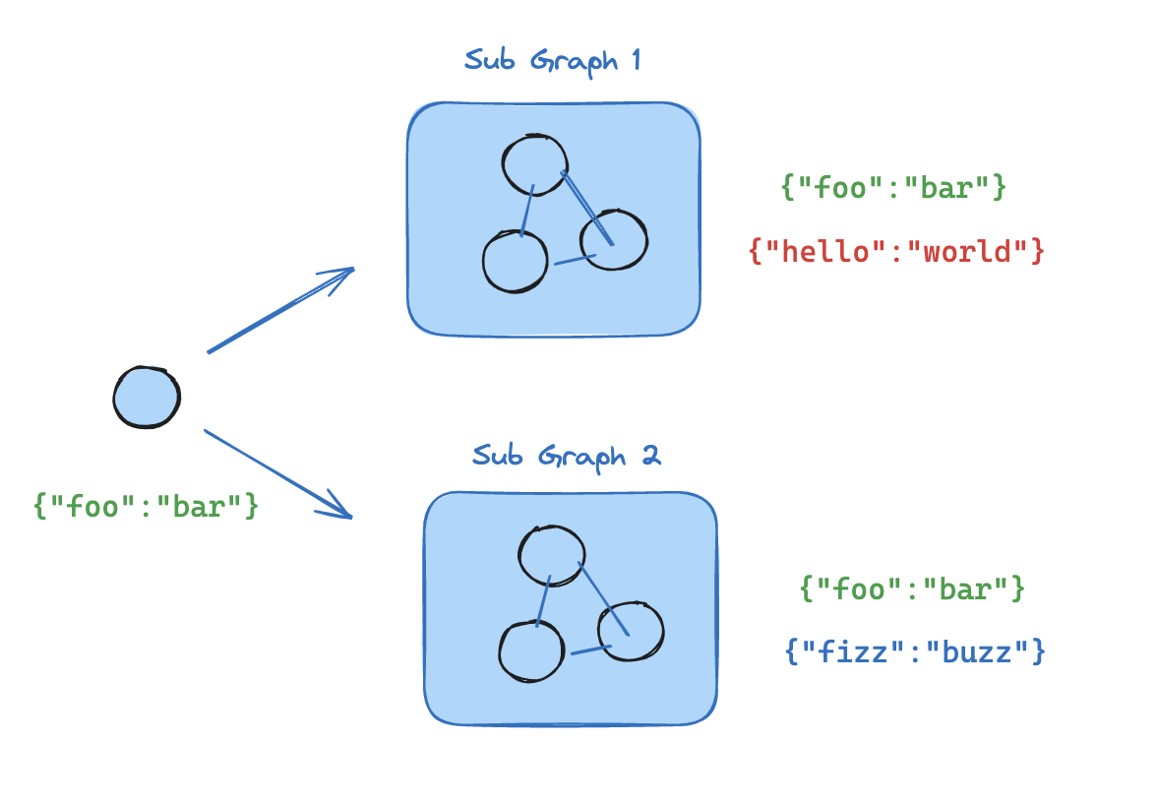
1. Think in Graph: SubGraph as a Node
Just simply invoke a pre-compiled graph in a node…….

Slide 8
2. Graph API

Slide 9
2. Graph API: Nodes, Edges, Compilation
Go over the docs with you very quick.
Graph API basically consist of three components: Adding nodes (optionally with new name), Adding (conditional or non-conditional) edges (START & END are strings so no worries) and Compilation.
I would not discuss reducer in detail since how to update state could be done within node.

Slide 10
2. Graph API: Let’s go over a comprehensive and practical example
https://docs.langchain.com/oss/python/langchain/multi-agent/router-knowledge-base

Slide 11
3. Super Step

Slide 12
3. Super Step
__start__
This workflow works in parallel after START node receives input.
For example, if the custom state has only one field “user_input” and the input is {“user_input”: “start: ”}
Then, what node_a does is to append “a” to the “user_input” field of state. Similarly, node_b would update state by appending “b” to “user_input” of state.
What node_c would see after it receives state from node_b?
A. {“user_input”: “start: a”}
B. {“user_input”: “start: b”}
C. {“user_input”: “start: ab”} or {“user_input”: “start: ba”}
node_a
node_b
node_d
node_c
__end__

Slide 13
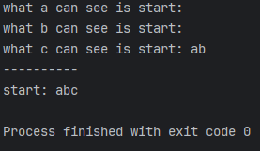
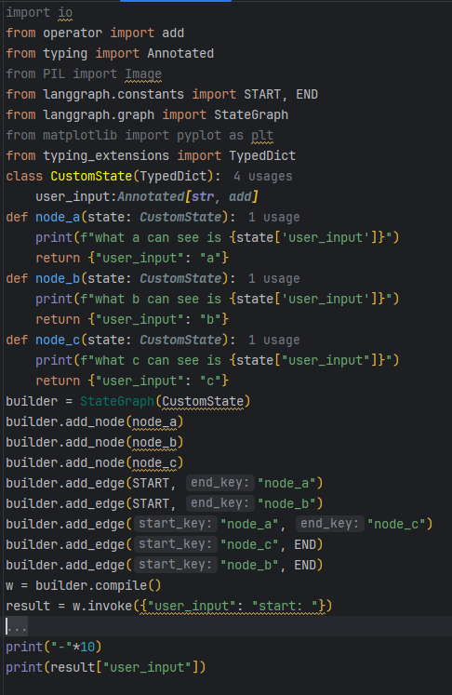
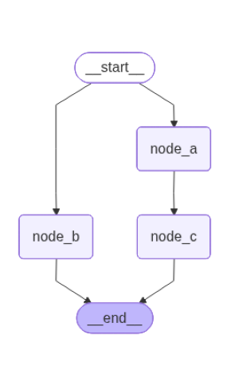
3. Super Step: Trickier one
What about this one?
What c could see after it receives state from node_a?

Slide 14
4. Hands-On Project Again

Slide 15
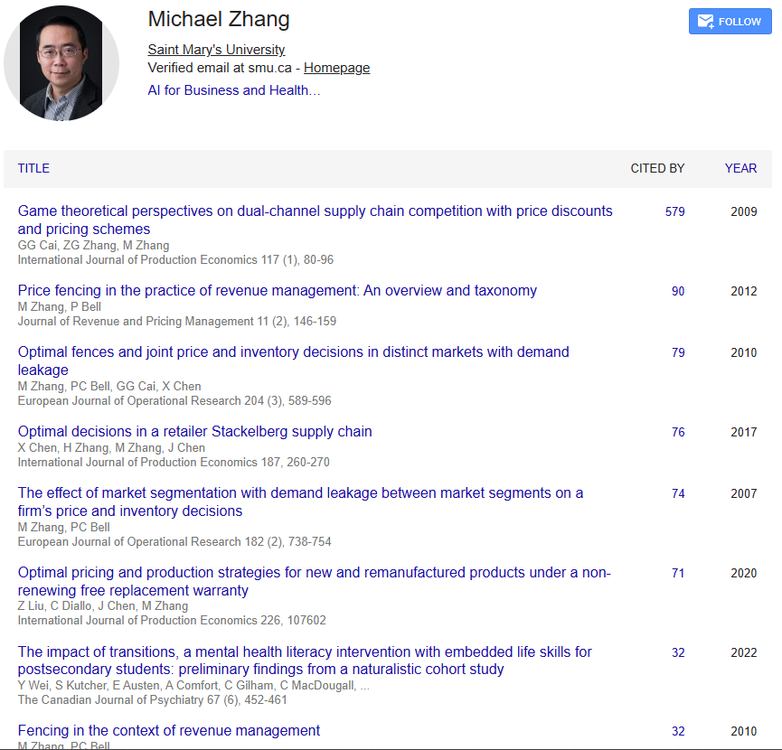
4. Hands-On Project: I want to see a lot of different designs
I know for a given task, there would be one or several designs of agentic workflow or workflow or multi-agent to accomplish. You are expected to create your own one and unleash your creativity.
Project Description: Make an agentic workflow or multi-agent application that emails Michael to express your interests of doing PhD with him.
At least, you need to create node/agent to search Michael’s academic information and research interests and then create nodes/agent to write emails, include HITL to request your explicit approval before sending emails. Bs4 could help again.
Since there is a lot of ways to do it, you have enough flexibility and freedom.
Use gmail to send email in Python because it’s much easier.
Don’t actually send the emails to Michael. Send the emails to me for testing (Yilin.Huang@smu.ca).

Slide 16
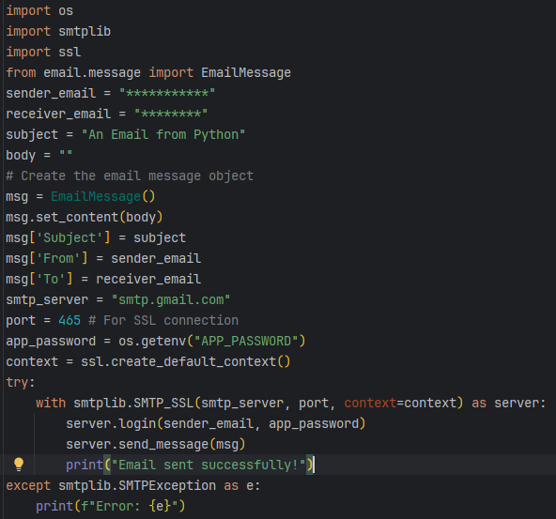
*Quick Notes
Regarding the email sending, when I was troubleshooting for someone using MacBook on Thursday, I noticed that “ssl.create_default_context” should be replaced by “ssl. _create_unverified_context”. Thanks to MR. A possibly helpful code snippet is attached on the LHS.
I wasn’t aware of Google Scholar’s blockage to web retrieval using bs4 and requests until Sunday, thanks to Dale. It’s suggested to use selenium to retrieve information about Dr. Michael from Google scholar.
A possibly helpful code snippet of selenium is uploaded in Brightspace.
(You need to install selenium and webdriver-manager using uv)
To use gmail in Python, please create an app password of your Google account. Please be advised that 2-step verification needs to be turned on before creating any app passwords.
Clarifications: Screenshot of Dr. Michael’s Google scholar profile indicates the fact that Dr. Michael is a scholar. Dr. Michael’s academic information is also available in SMU website(s).

Slide 17
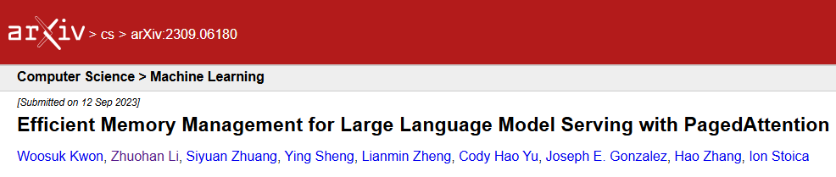
Thank you for your paged attention!

Slide 18


